Slide 1
MSCI training week on green digital finance
Kaunas University of Technology & Swedbank
Lithuania
30 June – 4 July 2025

Slide 2
Program and locations
30 June – 1 July, edu-Lab, Studentu 50-107, Kaunas
9:00 – 17:00 lectures and projects on green digital finance
17:30 (Monday), treasure hunt in the campus
2 July, Training at Swedbank, konstitucijos pr. 20, Vilnius
7:00 departure from Hotel Victoria, Misko 11, Kaunas
17:30 Departure form Swedbank
~19:00 arrival to Kaunas
3 – 4 July, edu-Lab, Studentu 50-107, Kaunas
9:00 – 17:00 lectures and projects on ethics
3 July 19:00 – dinner in traditional food restaurant
5 July 15:30 – 19:00 excursion in the city center

Slide 3
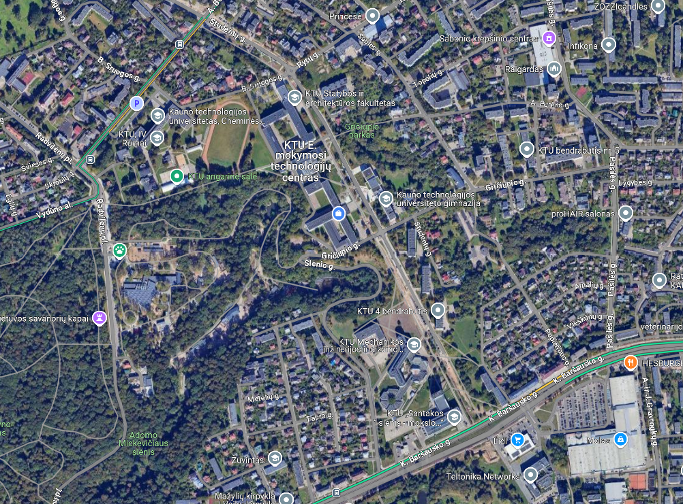
pre-event
Training
Departure bus stops
Arrival bus stops
lunches

Slide 4
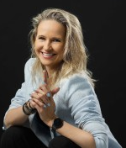
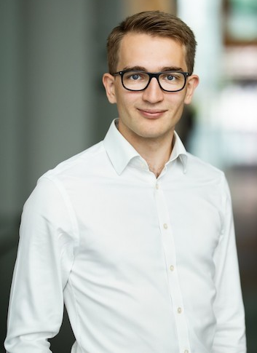
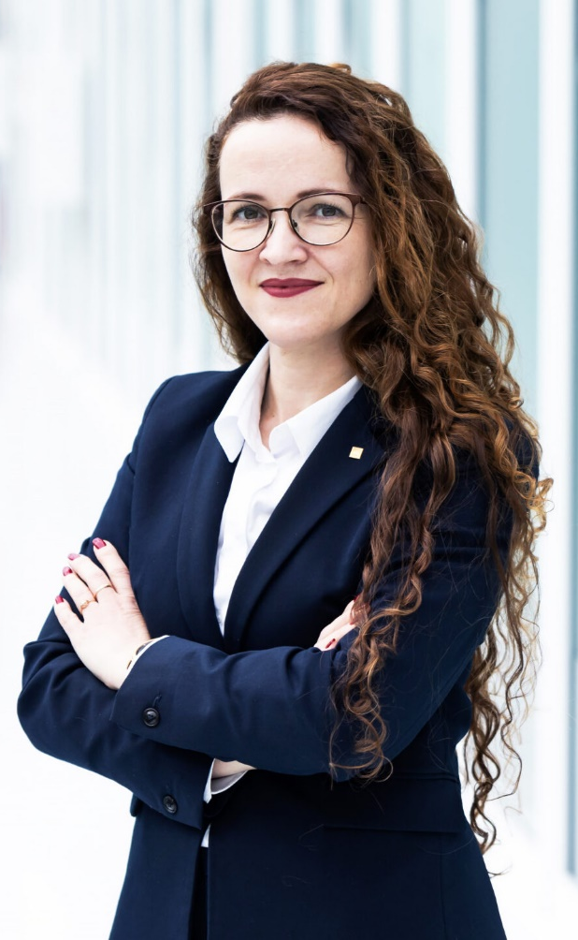
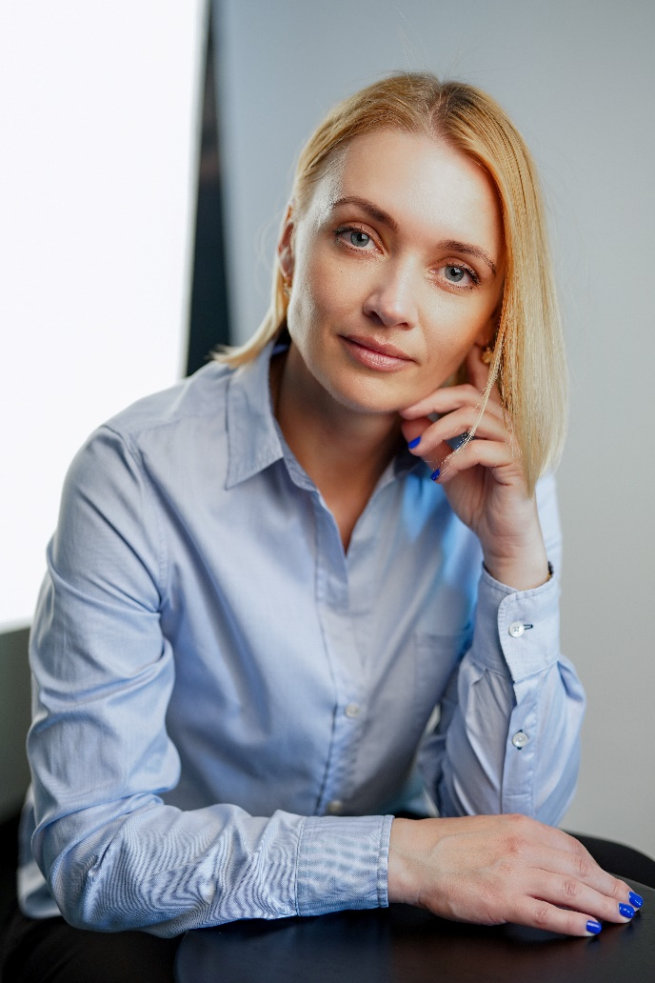
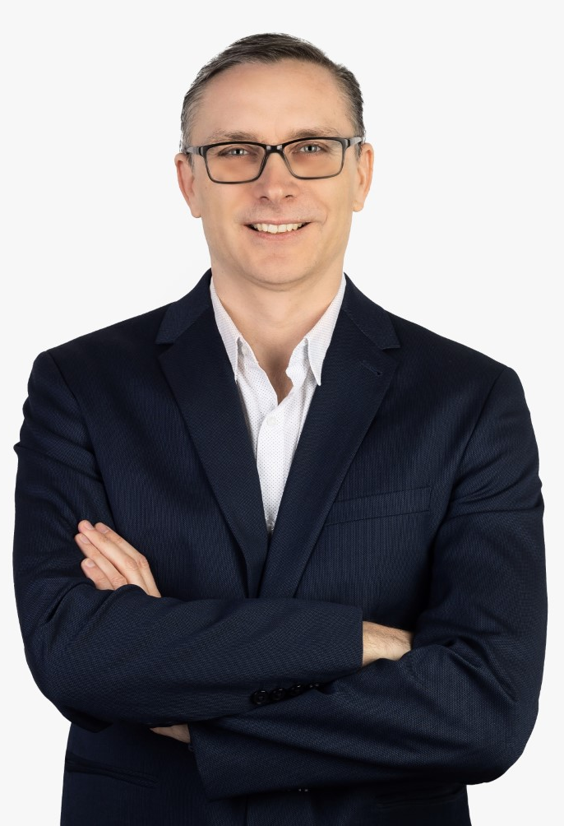
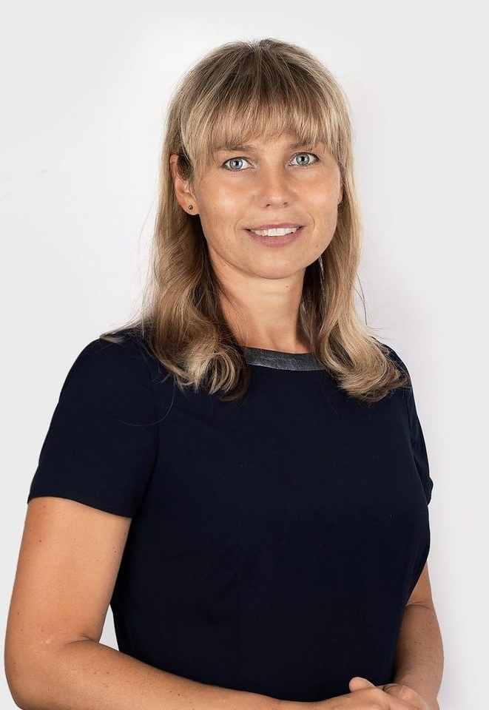
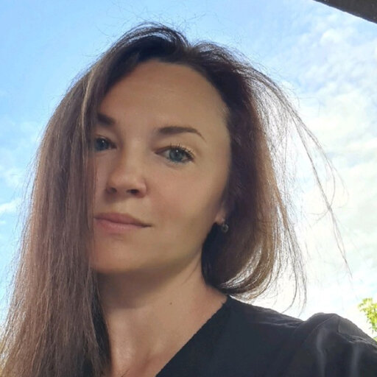
Instructors
Kristina Kundelienė
Eleonora Sakalauskaitė
Aidas Malakauskas
Kristina Šutienė
Jurgita Bruneckienė
Audrius Kabašinskas
Jurgita Černevičienėė

Slide 5
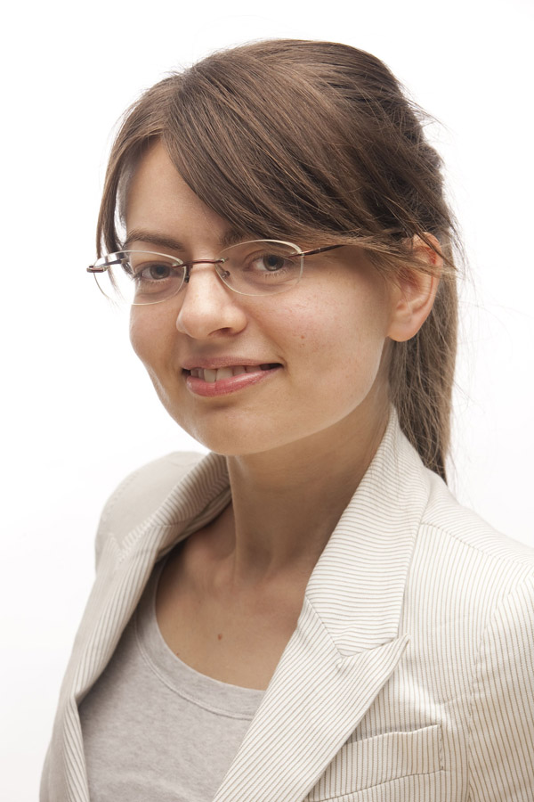
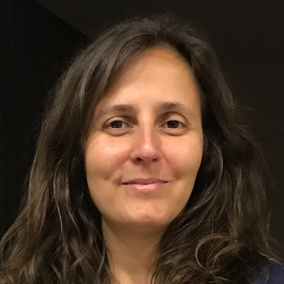
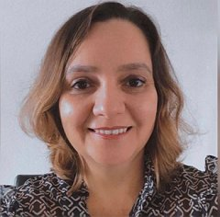
Instructors
Doina Bucur
Renata Guizzardi
Catarina Silva

Slide 6
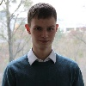
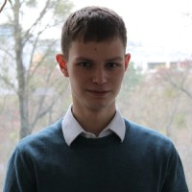
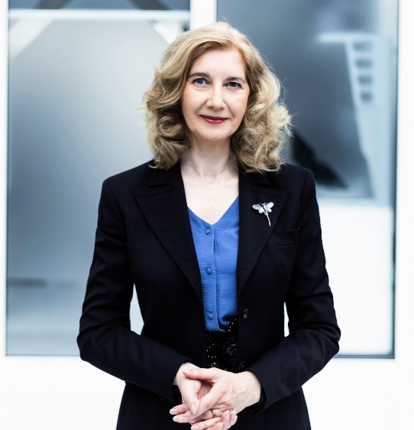
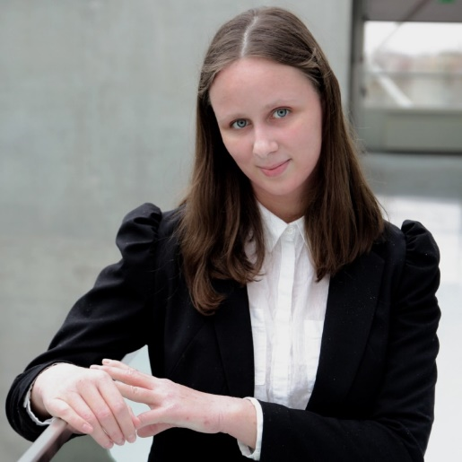
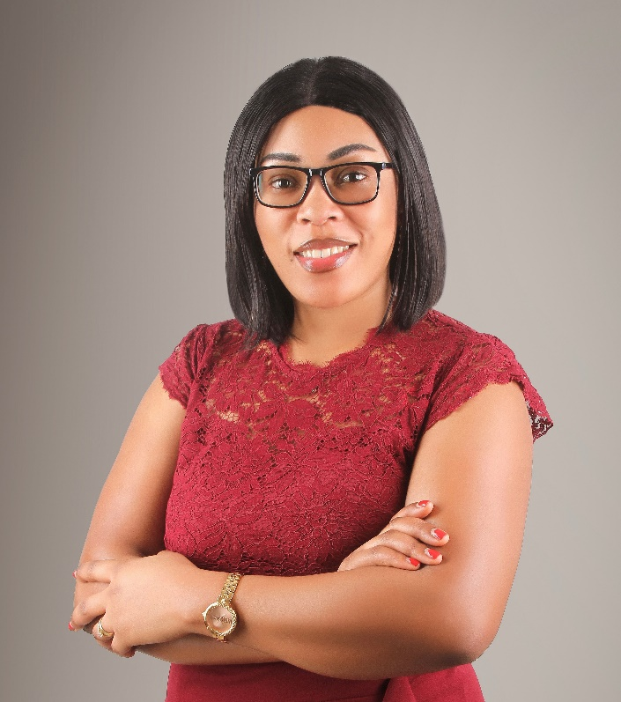
Organisers

